Slide 1
problem reduction

Slide 2
AND-OR Graphs contd…
The arcs are called as AND arcs.
Best-First Search algorithm cannot be used to solve AND-OR graphs.

Slide 3
Example 1
Tower of Hanoi:
Rules:
Only one disk can be moved at a time.
Each move consists of taking the uppermost disk from one of the rods and sliding it onto another rod, on top of the other disks that may already be present on that rod.
No disk may be placed on top of a smaller disk.

Slide 4
Example 1 contd…
Solution by decomposition:
Let n=no disks and the rods are marked as rod_1,rod_2,rod_3.
Requirement: To move from rod_1 to rod_3 or rod_2.
If n=1, then simply move rod_1 to rod_3 or rod_2.
If n>1, then move the smaller n-1 disks to rod_2 or rod_3 and place the largest disk on rod_3 or rod_2.

Slide 5
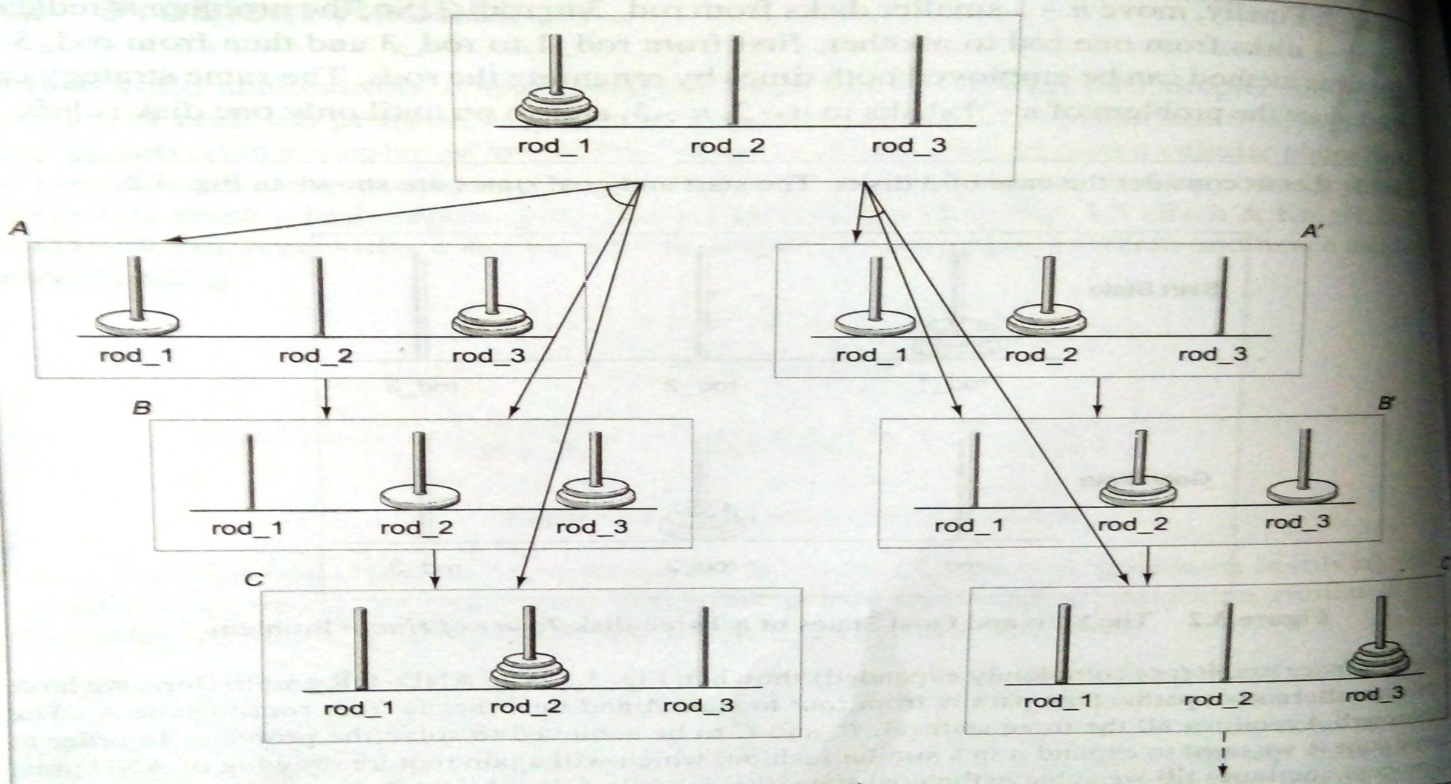
Example 1 contd…
AND-OR graph for three disks.

Slide 6
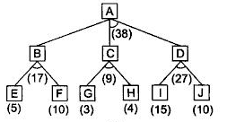

Example 2

Slide 7
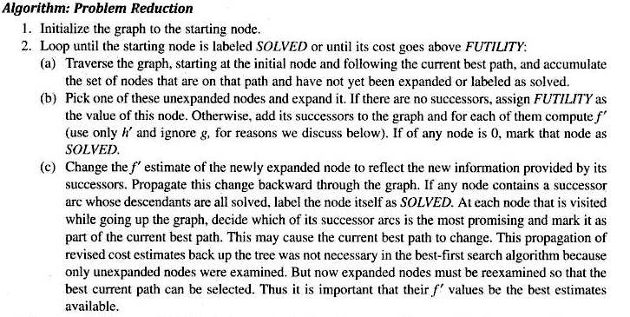
Algorithm

Slide 8
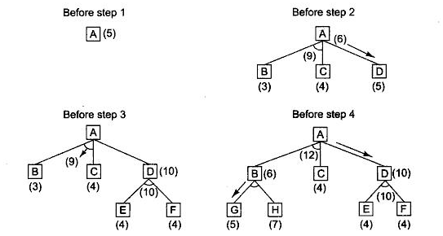
Example 1

Slide 9
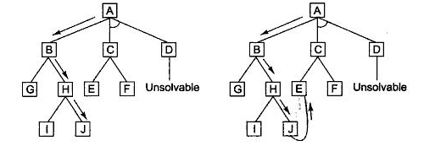
Example 2

Slide 10
AO* Algorithm
Let G be a graph with only starting node INIT.
Repeat the followings until INIT is labeled SOLVED or h(INIT) > FUTILITY
Select an unexpanded node from the most promising path from INIT (call it NODE)
Generate successors of NODE. If there are none, set h(NODE) = FUTILITY (i.e., NODE is unsolvable); otherwise for each SUCCESSOR that is not an ancestor of NODE do the following:
Add SUCCESSSOR to G.
If SUCCESSOR is a terminal node, label it SOLVED and set h(SUCCESSOR) = 0.
If SUCCESSPR is not a terminal node, compute its h

Slide 11
AO* Algorithm contd…
Propagate the newly discovered information up the graph by doing the following: let S be set of SOLVED nodes or nodes whose h values have been changed and need to have values propagated back to their parents. Initialize S to Node. Until S is empty repeat the followings:
Remove a node from S and call it CURRENT.
Compute the cost of each of the arcs emerging from CURRENT. Assign minimum cost of its successors as its h.
Mark the best path out of CURRENT by marking the arc that had the minimum cost in step ii
Mark CURRENT as SOLVED if all of the nodes connected to it through new labeled arc have been labeled SOLVED
If CURRENT has been labeled SOLVED or its cost was just changed, propagate its new cost back up through the graph. So add all of the ancestors of CURRENT to S.

Slide 12
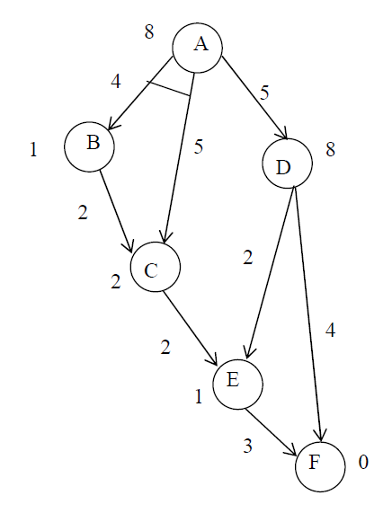
Example

Slide 13
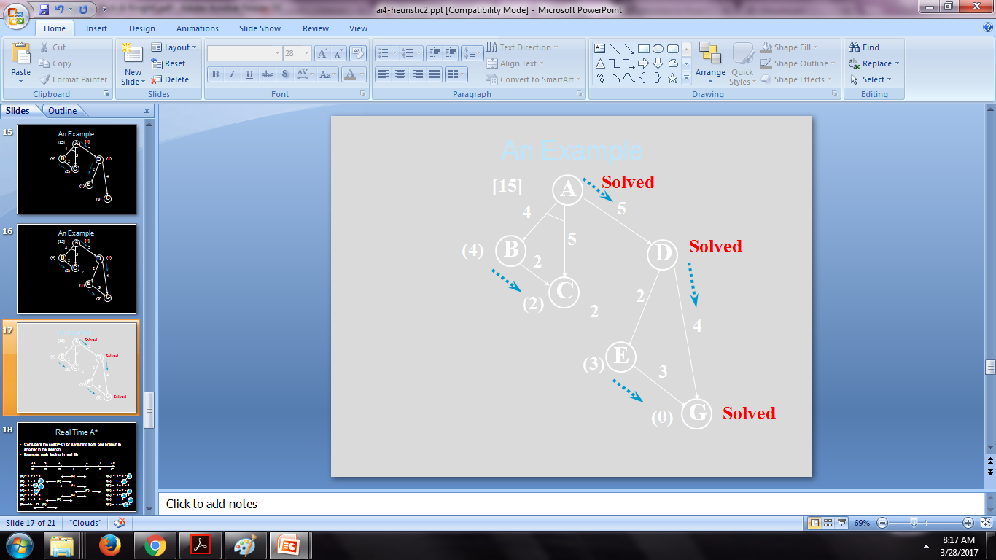
Example contd..

Slide 14
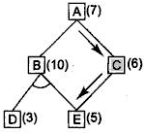
Unnecessary backward progagation

Slide 15
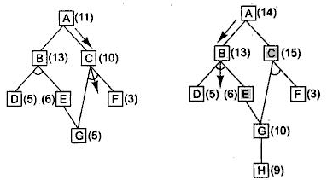
Necessary backward propagation

Slide 16

Constraint Satisfaction
Problems where some states have to satisfy a given set of constraints.
Constraint Satisfaction is a serach procedure which operates in a set of constraints.
Example: n-Queen problem, cryptarithmetic puzzles.

Slide 17
Constraint Satisfaction contd…
Step 1: Propagate through the system by satisfying some constraints.
Step 2: Make some hypothesis to strengthen the constraint.

Slide 18
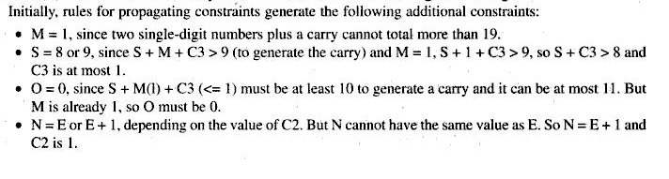
Solution

Slide 19
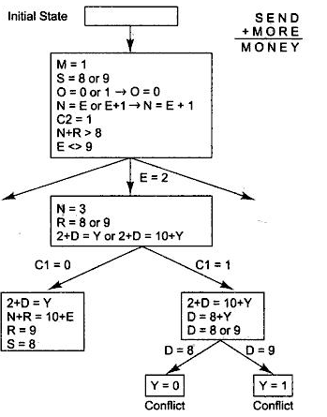
Solution contd…

